Slide 2
Spatial Database
A general-purpose database (often a relational database) improved to contain spatial information that represents
Objects specified in a geometric space and
Tools for searching and analyzing such data
Spatial Database Components
1. Spatial Data Storage:
Spatial databases store and manage basic geometric objects such as points, lines, polygons, and other geometric shapes specified by open geospatial consortium(OGC)
Some Spatial Databases can handle more complicated structures, including triangulated irregular networks, topological coverages, and 3D objects.
These databases use specialized indexing and data structures to efficiently handle spatial data.
Spatial Databases must support the tracking and manipulation of coordinate systems since every geographic place must be described using a spatial reference system. In many systems, a choice of a coordinate system is included when a spatial column is defined in a table. This choice is made from a list of possible systems that are kept in a lookup table.
Traditional databases have evolved to manage a variety of character and numeric data types, but to process spatial data types effectively, and these databases need additional capability, which is why developers frequently include geometries or feature data types.
Nearly all relational and Object-relational Database Management Systems currently in use have spatial extensions, and a few GIS software companies have created their own spatial extensions for Database Management Systems.

Slide 3
2. Spatial Objects:
Points:
Represents a single location in space defined by coordinates.
Lines:
Sequences of connected points forming a path or a route.
Polygons:
Enclosed areas defined by a series of connected points, forming a closed shape.
Geometry Collections:
Containers for multiple spatial objects of different types.
Curves and Surfaces:
Some spatial databases support more complex shapes like curves and surfaces.
3. Spatial Dimensions:
2D vs. 3D Spatial Data:
Spatial databases can handle both two-dimensional (2D) and three-dimensional (3D) spatial data.
Temporal Dimension:
Some spatial databases also incorporate time as a dimension, allowing for the storage and querying of spatiotemporal data.

Slide 4
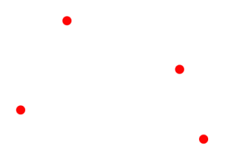
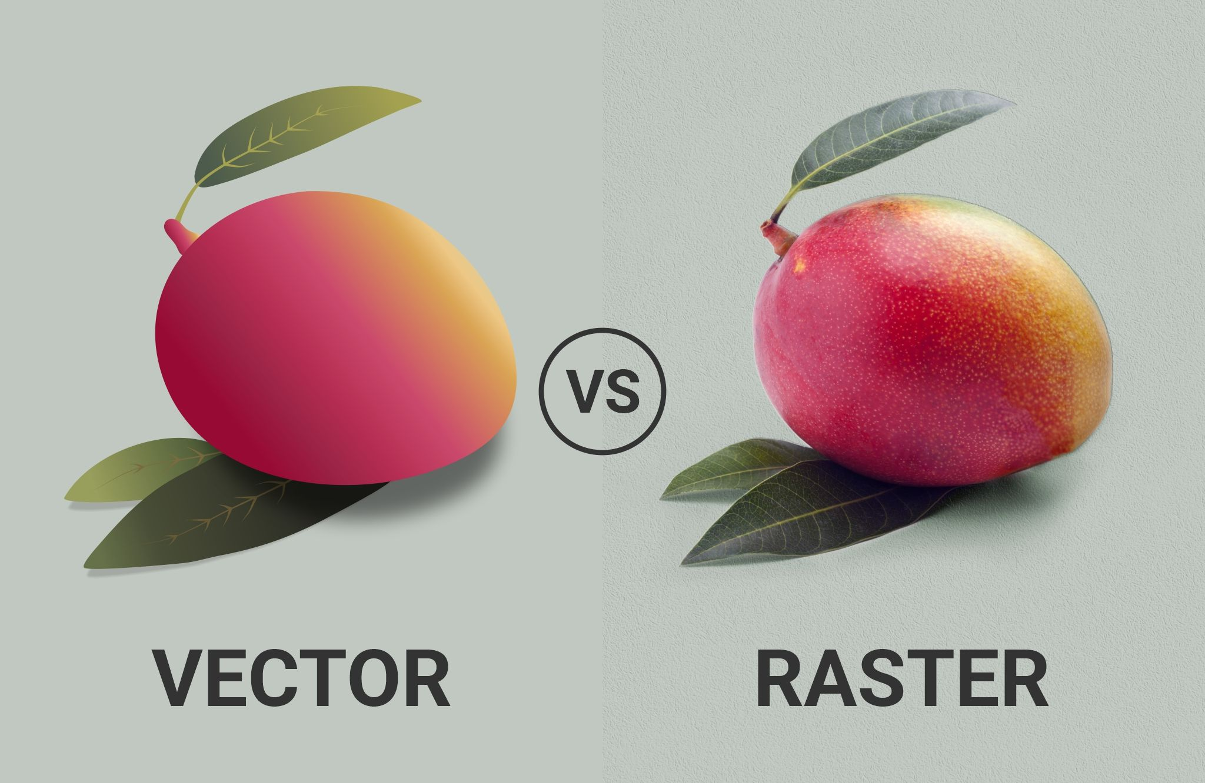
Storage of spatial data as vector data model or raster data model
According to the vector data model the storage of data is using a single spatial value which is often a geometric primitive (points, lines, polygon, etc.)
Vectors are points, lines, and polygons
Vector data is not made up of a grid of pixels. Instead, vector graphics are comprised of vertices and paths.
Vector points are simply XY coordinates. Generally, they are latitude and longitude with a spatial reference frame.
When features are too small to be represented as polygons, points are used.
For example, you can’t see city boundary lines on a global scale. In this case, maps often use points to display cities.
Continuous data is poorly stored and displayed as vectors. If you want to display continuous data as a vector, it would require substantial generalization. Although topology is useful for vector data, it is often processing intensive. Any feature edits require updates on topology. With a lot of features, vector manipulation algorithms are complex
Notes:
Vector data level of details is very less compare to raster data

Slide 5
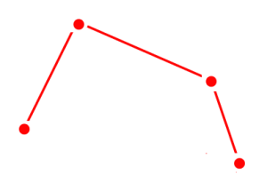
Lines connect vertices
Vector lines connect each vertex with paths. Basically, you’re connecting the dots in a set order and it becomes a vector line with each dot representing a vertex.
Lines usually represent features that are linear in nature.
For example, maps show rivers, roads, and pipelines as vector lines. Often, busier highways have thicker lines than abandoned roads.
On the other hand, networks are line data sets but they are often considered to be different. This is because linear networks are topologically connected elements. They consist of junctions and turns with connectivity.
If you were to find an optimal route using a traffic line network, it would follow set rules. For example, it can restrict turns and movement on one-way streets.

Slide 6
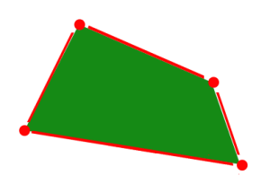
Polygons connect vertices and close the path
When you join a set of vertices in a particular order and close it, this is now a vector polygon feature. When you create a polygon, the first and last coordinate pairs are the same.
Cartographers use polygons to show boundaries and they all have an area.
For example, a building footprint has square footage and agricultural fields have acreage.
Raster Types: Discrete vs Continuous
Raster data is made up of pixels (also referred to as grid cells).
They are usually regularly spaced and square but they don’t have to be.
Rasters often look pixelated because each pixel has its own value or class.
For example:
Each pixel value in a satellite image has a red, green, and blue value. Alternatively, each value in an elevation map represents a specific height. It could represent anything from rainfall to land cover.

Slide 7
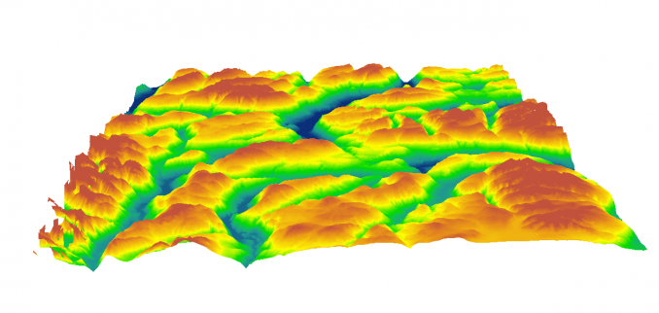
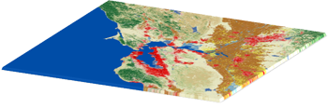

Raster models are useful for storing data that varies continuously.
For example, elevation surfaces, temperature, and lead contamination.
Raster data models consist of 2 categories – discrete and continuous.
Discrete Rasters have distinct values
Discrete rasters have distinct themes or categories. For example, one grid cell represents a land cover class or a soil type.
network analysis and proximity operations use vector data structures.

Slide 8

Continuous Rasters have a gradual change
Continuous rasters (non-discrete) are grid cells with gradually changing data such as elevation, temperature
A continuous raster surface can be derived from a fixed registration point. For example, digital elevation models use sea level as a registration point.
Each cell represents a value above or below sea level.
Phenomena can gradually vary along a continuous raster from a specific source.
A raster depicting an oil spill can show how the fluid moves from high concentration to low concentration. At the source of the oil spill, concentration is higher and diffuses outwards with diminishing values as a function of distance.
A raster grid format is a data model for satellite data and other remote sensing data. For raster positions, it’s simple to understand cell size.

Slide 9
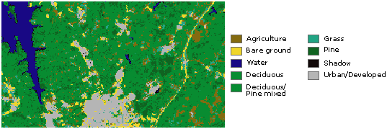
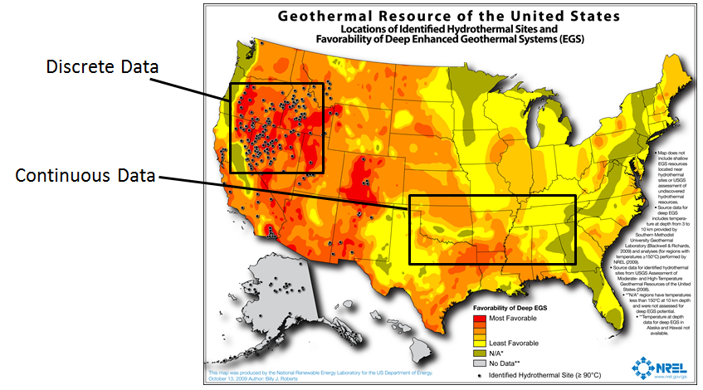
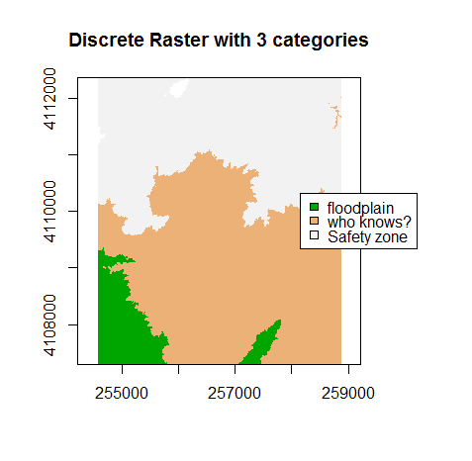

Slide 10
Spatial Relations:
Distance:
Measures the spatial separation between two or more spatial objects.
Intersection:
Determines whether two spatial objects share a common area or point.
Containment:
Checks if one spatial object is entirely within another.
Proximity:
Identifies spatial objects that are close to each other.
Topological Relations:
Describes the spatial relationships in terms of boundaries, interiors, and exteriors.
services.

Slide 11
Spatial SQL Queries:
SELECT Statements:
Retrieve spatial data from the database.
Spatial Operators:
Use operators like ST_Within, ST_Intersects to perform spatial operations in queries.
Index Utilization:
Leverage spatial indexing for optimized query performance.
Aggregation Functions:
Calculate spatial statistics or aggregate spatial data.
Join Operations:
Combine spatial data from multiple tables based on spatial relationships.
Spatial Analysis Functions:
Perform spatial analyses, such as buffering, overlay, and nearest neighbor search.
Spatial databases, such as PostgreSQL with PostGIS, Oracle Spatial, or Microsoft SQL Server with Spatial Extensions, are popular choices for managing and querying spatial data. They play a crucial role in applications like Geographic Information Systems (GIS) and location-based services.

Slide 12
Geodatabase:
A Geographic Database, sometimes known as a Geodatabase, is a Georeferenced Spatial Database that is used to store and modify geodata or information about a specific place on Earth.
Additionally, the term "geodatabase" can refer to a collection of exclusive geographic database formats called Geodatabase (Esri).
For instance, a city might connect and use datasets from common spatial databases for its wastewater department, land registry, transportation, and fire services.

Slide 13
Value of SDBMS
Traditional (non-spatial) database management systems provide:
Persistence across failures
Allows concurrent access to data
Scalability to search queries on very large datasets which do not fit inside main memories of computers
Efficient for non-spatial queries, but not for spatial queries
Non-spatial queries:
List the names of all bookstore with more than ten thousand titles.
List the names of ten customers, in terms of sales, in the year 2001
Spatial Queries:
List the names of all bookstores with ten miles of Minneapolis
List all customers who live in Tennessee and its adjoining states

Slide 14
Value of SDBMS – Spatial Data Examples
Examples of non-spatial data
Names, phone numbers, email addresses of people
Examples of Spatial data
Census Data
NASA satellites imagery - terabytes of data per day
Weather and Climate Data
Rivers, Farms, ecological impact
Medical Imaging
Exercise: Identify spatial and non-spatial data items in
A phone book
A cookbook with recipes

Slide 15
Value of SDBMS – Users, Application Domains
Many important application domains have spatial data and queries. Some Examples follow:
Army Field Commander: Has there been any significant enemy troop movement since last night?
Insurance Risk Manager: Which homes are most likely to be affected in the next great flood on the Mississippi?
Medical Doctor: Based on this patient's MRI, have we treated somebody with a similar condition ?
Molecular Biologist:Is the topology of the amino acid biosynthesis gene in the genome found in any other sequence feature map in the database ?
Astronomer:Find all blue galaxies within 2 arcmin of quasars.

Slide 16
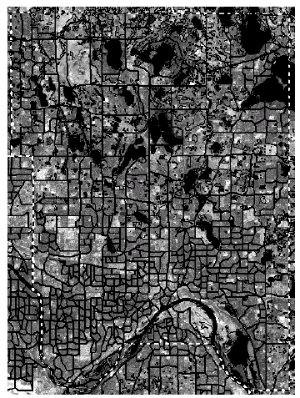
SDBMS Example
Consider a spatial dataset with:
County boundary (dashed white line)
Census block - name, area, population, boundary (dark line)
Water bodies (dark polygons)
Other objects in Satellite Imagery (gray scale pixels)
Storage in a SDBMS table:
create table census_blocks (
name string,
area float,
population number,
boundary polygon );
Fig 1.2

Slide 17
Modeling Spatial Data in Traditional DBMS
A row in the table census_blocks (Figure 1.3)
Question: Is Polyline datatype supported in DBMS?
Figure 1.3

Slide 18
Spatial Data Types and Traditional Databases
Traditional relational DBMS
Support simple data types, e.g. number, strings, date
Modeling Spatial data types is tedious
Example: Figure 1.4 shows modeling of polygon using numbers
Three new tables: polygon, edge, points
Note: Polygon is a polyline where last point and first point are same
A simple unit sqaure represented as 16 rows across 3 tables
Simple spatial operators, e.g. area(), require joining tables
Tedious and computationally inefficient
.

Slide 19
Mapping “census_table” into a Relational Database
Fig 1.4

Slide 20
How is a SDBMS different from a GIS ?
GIS is a software to visualize and analyze spatial data using spatial analysis functions such as
Search Thematic search, search by region, (re-)classification
Location analysis Buffer, corridor, overlay
Terrain analysis Slope/aspect, catchment, drainage network
Flow analysis Connectivity, shortest path
Distribution Change detection, proximity, nearest neighbor
Spatial analysis/Statistics Pattern, centrality, autocorrelation, indices of similarity, topology: hole description
Measurements Distance, perimeter, shape, adjacency, direction
GIS uses SDBMS
to store, search, query, share large spatial data sets
Notes:
GIS: Geographic Information Systems

Slide 21
How is a SDBMS different from a GIS ?
SDBMS focusses on
Efficient storage, querying, sharing of large spatial datasets
Provides simpler set based query operations
Example operations: search by region, overlay, nearest neighbor, distance, adjacency, perimeter etc.
Uses spatial indices and query optimization to speedup queries over large spatial datasets.
SDBMS may be used by applications other than GIS
Astronomy, Genomics, Multimedia information systems, ...
Will one use a GIS or a SDBM to answer the following:
How many neighboring countries does USA have?
Which country has highest number of neighbors?
Notes:
GIS: Geographic Information Systems

Slide 22
Components of a SDBMS
Recall: a SDBMS is a software module that
can work with an underlying DBMS
supports spatial data models, spatial ADTs and a query language from which these ADTs are callable
supports spatial indexing, algorithms for processing spatial operations, and domain specific rules for query optimization
Components include
spatial data model, query language, query processing, file organization and indices, query optimization, etc.
Figure 1.6 shows these components
We discuss each component briefly in chapter 1.6 and in more detail in later chapters.

Slide 23
Three Layer Architecture
Fig 1.6

Slide 24
Spatial Data Models
Spatial data models
rules to identify identifiable objects and properties of space
Object model help manage identifiable things, e.g. mountains, cities, land-parcels etc.
Field model help manage continuous and amorphous phenomenon, e.g. wetlands, satellite imagery, snowfall etc.

Slide 25
Spatial Query Language
Spatial query language
Spatial data types, e.g. point, linestring, polygon, …
Spatial operations, e.g. overlap, distance, nearest neighbor, …
Callable from a query language (e.g. SQL3) of underlying DBMS
SELECT S.name
FROM Senator S
WHERE S.district.Area() > 300
Standards
SQL3 (a.k.a. SQL 1999) is a standard for query languages
OGIS is a standard for spatial data types and operators
Both standards enjoy wide support in industry

Slide 26
Multi-scan Query Example
Spatial join example
SELECT S.name FROM Senator S, Business B
WHERE S.district.Area() > 300 AND Within(B.location, S.district)
Non-Spatial Join example
SELECT S.name FROM Senator S, Business B
WHERE S.soc-sec = B.soc-sec AND S.gender = ‘Female’
Fig 1.7

Slide 27
Query Processing
Efficient algorithms to answer spatial queries
Common Strategy - filter and refine
Filter Step:Query Region overlaps with MBRs of B,C and D
Refine Step: Query Region overlaps with B and C
Fig 1.8
Notes:
Minimum bounding rectangles

Slide 28
Spatial Indexing: Search Data-Structures
Choice for spatial indexing:
B-tree is a hierarchical collection of ranges of linear keys, e.g. numbers
B-tree index is used for efficient search of traditional data
B-tree can be used with space filling curve on spatial data
R-tree provides better search performance yet!
R-tree is a hierarchical collection of rectangles
More details in chapter 4
Fig 1.12: B-tree
Fig. 1.13: R- tree
Notes:
The primary goal of an R-tree is to store and index spatial objects, such as points, rectangles, or other geometric shapes, in a way that facilitates spatial queries. The structure of an R-tree is hierarchical and consists of nodes, each representing a bounding box that encloses a group of spatial objects. The leaves of the tree contain the actual spatial objects along with their corresponding data.

Slide 29
Query Optimization
Query Optimization
A spatial operation can be processed using different strategies
Computation cost of each strategy depends on many parameters
Query optimization is the process of
ordering operations in a query and
selecting efficient strategy for each operation
based on the details of a given dataset
Example Query:
SELECT S.name FROM Senator S, Business B
WHERE S.soc-sec = B.soc-sec AND S.gender = ‘Female’
Optimization decision examples
Process (S.gender = ‘Female’) before (S.soc-sec = B.soc-sec )
Do not use index for processing (S.gender = ‘Female’)

Slide 30
Data Mining
Analysis of spatial data is of many types
Deductive Querying, e.g. searching, sorting, overlays
Inductive Mining, e.g. statistics, correlation, clustering,classification, …
Data mining is a systematic and semi-automated search for interesting non-trivial patterns in large spatial databases
Example applications include
Infer land-use classification from satellite imagery
Identify cancer clusters and geographic factors with high correlation
Identify crime hotspots to assign police patrols and social workers

Slide 31
Summary
SDBMS is valuable to many important applications
SDBMS is a software module
works with an underlying DBMS
provides spatial ADTs callable from a query language
provides methods for efficient processing of spatial queries
Components of SDBMS include
spatial data model, spatial data types and operators,
spatial query language, processing and optimization
spatial data mining
SDBMS is used to store, query and share spatial data for GIS as well as other applications

Slide 32
